Slide 1
Discovery Days Hack
Pradeep Kumar John Manaloto William H. Salazar

Slide 2
Containers on Azure Overview

Slide 3
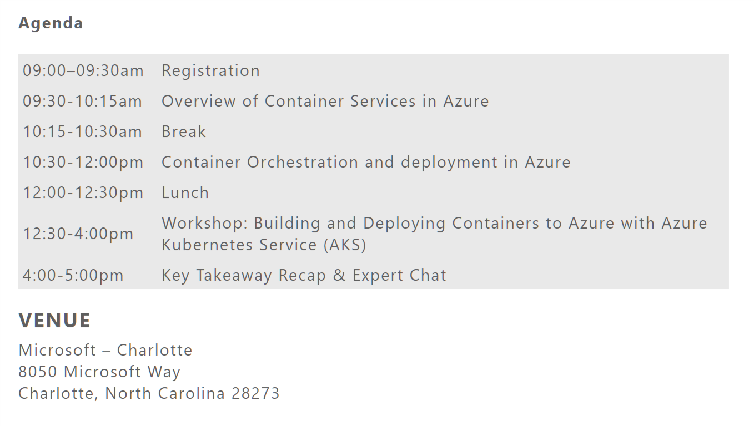

Slide 4
Presenter guidance
Title | Containers on Azure overview
Main Object | Discuss the benefits of containers esp, for application modernization scenarios Introduce the container platforms on Azure and share their respective scenarios
Audience | TDMs
Delivered by
Content Level | 200
Deck Owner | Stella Lin
Usage Guidance | 30 min discussion and deep dive to respective service(s) for selected scenario(s)
Version | 1.4
NEXT: <next slide title>

Slide 5
Widening divide between business and IT
Business needs
IT challenges
Rapid innovation to transform products
Close the gap from data to decision
Connect with customers and empower employees
72% of IT budgets are dedicated towards maintenance (‘keeping the lights on’).
Only half of all decision makers got help from technologists with their analysis needs
Demand for mobile apps >5x the capacity of IT

Slide 6

Are your systems ready for these challenges?

Slide 7

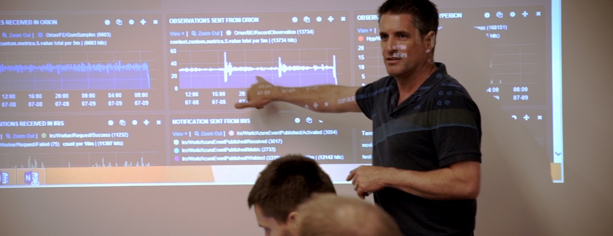
Why modernize?
Reasons to modernize
Aging infrastructure
Low efficiency and reliability.
High operational costs and capital expenditure.
Growing security, audit, and compliance requirements.
Inflexible and unable to keep up with business growth.
Stagnant architecture
Legacy stack and code.
Long deployment times and release cycles.
Incompatibilities with modern software systems.
It’s hard or impossible to add new functionality.
Innovation is happening outside IT, unmanaged.
Modernization benefits
Turn CapEx into OpEx
Increased operational efficiency
Get out of the data center business.
Meet security and compliance requirements.
Reduce time and budget spent on infrastructure management.
Rapid innovation
Ship new capabilities faster.
Achieve scalability with confidence.
Better collaboration across business, Ops, IT and dev teams.

Slide 8
The benefits of using containers
Agility
Ship apps faster
Portability
Easily move workloads
Density
Achieve resource efficiency
Rapid scale
Scale easily to meet demand

Slide 9
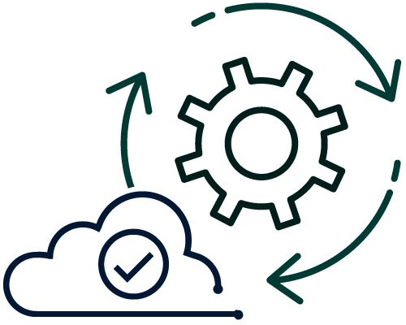
From traditional systems to portfolio of modern apps
App
Container
App
Existing/New Applications
Containerize Applications
Each host often runs 8 containers at a time¹
Microservices
Seconds to deploy, churns 12x faster¹
Continuous innovation with DevOps
46x more frequent for code delivery²
Source:
1: Datadog Report: 8 Surprising Facts About Real Docker Adoption; 2: 2017 state of DevOps Report

Slide 10
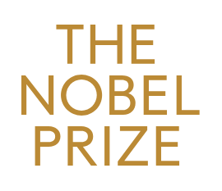


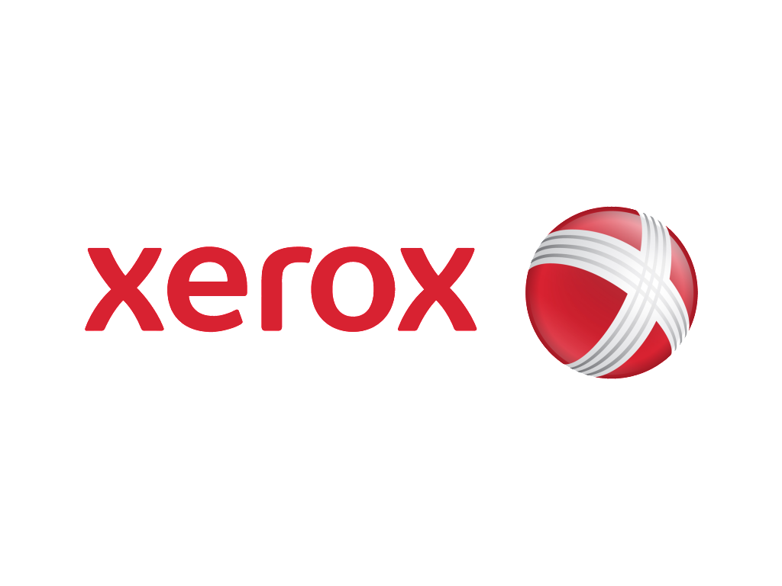


Customer momentum
Connect medical devices to the cloud
Modernize the digital home of the Nobel Prize
Improve mobile service delivery of online shopping cart
Success
Speed of product development significantly increased
Success
Greatly reduced management overhead of infrastructure
Success
10 seconds to deploy API vs 20 minutes
Faster demo environment releases
Deliver an industry leading customer service
Consolidate data from disparate systems to understand customers
Success
Demo environments in 10 minutes instead of 24 hours
Success
100% automated deployment, potentially saving 33% on run cost
Success
50% reduction in time for data management and analysis

Slide 11
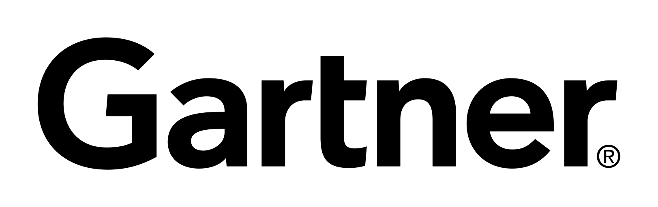
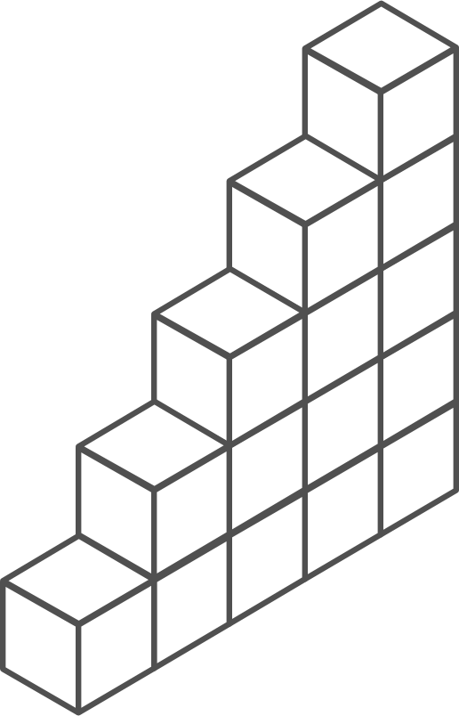
Containers momentum
“By 2020, more than 50% of enterprises will run mission-critical, containerized cloud-native applications in production.”
Half of container environment is orchestrated.¹
77%
77% of companies² who use container orchestrators choose Kubernetes.
The average size of a container deployment has grown 75% in one year. ¹
Larger companies are leading the adoption.¹
75%
50%
Nearly 50% of organizations¹ running 1000 or more hosts have adopted containers.
¹ Datadog report: 8 Surprising Facts About Real Docker Adoption
² CNCF survey: cloud-native-technologies-scaling-production-applications

Slide 12
What is a container?
App
Container
App
Virtual machines
Containers
Virtualize the hardware
VMs as units of scaling
Virtualize the operating system
Applications as units of scaling

Slide 13


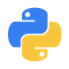

The benefits of using containers
Any OS
Anywhere
Any app
Any language
Java
Linux
On-premises
Monolith
.Net
Python
Windows
Cloud
Microservice
Node

Slide 14
The container advantage
Traditional virtualized environment
VM
VM
Low utilization of container resources
Containerization of applications and their dependencies for portability
Application
Con.
Con.
Application
Con.
Con.
From dev to production agility across development and operations teams
Hypervisor 2
Host OS
Hardware

Slide 15
The container advantage
Containerized environment
Migrate containers and their dependencies to underutilized VMs for improved density and isolation
VM
VM
Con.
Con.
Decommission unused resources for efficiency gains and cost savings
Con.
Con.
Container is lighter weight and faster to scale dynamically
Docker Engine
Host OS
Hardware

Slide 16
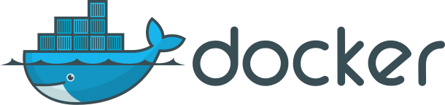
What is ?
An open source container runtime
Mac, Windows and Linux support
# The world’s simplest Dockerfile
$ cat Dockerfile
FROM scratch
COPY hello /
CMD ["/hello"]
# Let’s create a docker image “tagged” hello-world
$ docker build –t hello-world .
# And run it…
$ docker run hello-world

Slide 17
The elements of orchestration
Scheduling
Affinity/anti-affinity
Health monitoring
Failover
Scaling
Networking
Service discovery
Coordinated app upgrades

Slide 18
Kubernetes: empowering you to do more
Portable
Public, private, hybrid, multi-cloud
Extensible
Modular, pluggable, hookable, composable
Self-healing
Auto-placement, auto-restart, auto-replication, auto-scaling
Deploy your applications quickly and predictably
Scale your applications on the fly
Roll out new features seamlessly
Limit hardware usage to required resources only

Slide 19
Containers on Azure
Flexibility
Productivity
Trust
Deploy containerized applications in your preferred environment
Accelerate containerized application development
Manage, monitor, and help secure your containers

Slide 20

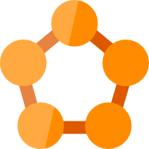

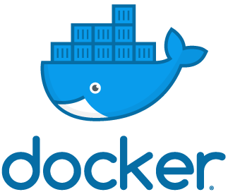



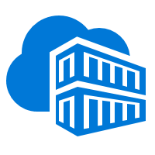
Containers in Azure
App Service
Service Fabric
Kubernetes Service
Container Instance
Ecosystem
Deploy web apps or APIs using containers in a PaaS environment
Modernize .NET applications to microservices using Windows Server containers
Scale and orchestrate Linux containers using Kubernetes
Elastically burst from your Azure Kubernetes Service (AKS) cluster
Bring your Partner solutions that run great on Azure
Azure Container Registry
Docker Hub
Choice of developer tools and clients

Slide 21
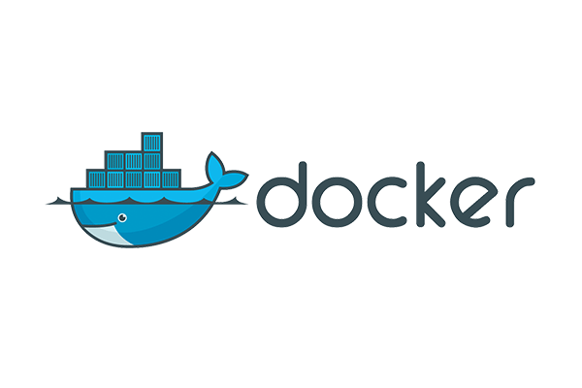



If you have a preferred container platform Pivotal Cloud Foundry  Kubernetes  Docker Enterprise Edition Red Hat OpenShift  Mesosphere DC/OS
Flexibility
Productivity
Trust
Pivotal Cloud Foundry
Self-managed Kubernetes
Docker Enterprise Edition
Red Hat OpenShift
Mesosphere DC/OS
You could bring that platform to Azure

Slide 22
If you are without a preferred container platform…
Flexibility
Productivity
Trust
Let’s profile your needs and help you select the right option

Slide 23


Choose the platform that meet your container needs
Flexibility
Productivity
Trust
Deploy web apps or APIs using Linux containers in a PaaS environment
Azure App Service
Scale and orchestrate Linux containers using Kubernetes
Azure Kubernetes Service (AKS)
Lift, shift and modernize .NET applications to microservices using Windows Server containers
Azure Service Fabric

Slide 24
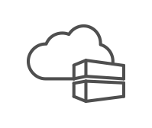
Productivity Accelerate containerized application development
Flexibility
Productivity
Trust
Automatically containerize and scaffold any applications directly from IDE
Auto-build to a secure container registry
Rapidly iterate, test and debug microservices
A few clicks to receive a full CI/CD pipeline
Built-in monitoring and logging to get full visibility of container health and app telemetry

Slide 25


Productivity Choose from 100+ services from Marketplace
Flexibility
Productivity
Trust
Database
IoT
Security
Container platform of your choice
Storage
Intelligence
Analytics
Azure
Cache
Integration
OSS services

Slide 26
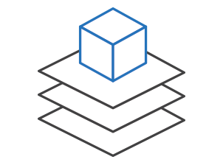

Trust Manage, monitor, and secure your containers
Flexibility
Productivity
Trust
Efficiently manage container images
Manage a Docker private registry as a first-class Azure resource with Container Registry. Manage container images with familiar, open-source Docker command-line interface (CLI) tools.
Gain visibility into your containers
Get a full view of your container deployment. View centralized CPU, memory, storage, and network and performance information with tools like Application Insights and Log Analytics.
Integrate security with container applications
Provide full-stack security for your containers including vulnerability scanning, run-time protection, and compliance. Add single sign-on with Azure Active Directory.

Slide 27


Azure Kubernetes Service (AKS)
Azure Kubernetes Service (AKS)
Simplify the deployment, management, and operations of Kubernetes
App Service
Azure Container Instances (ACI)
Deploy and manage Kubernetes with ease
Scale and run applications with confidence
Secure your Kubernetes environment
Service Fabric
Azure Batch
Accelerate containerized application development
Work how you want with open-source tools & APIs
Set up CI/CD in a few clicks
Azure Container Registry (ACR)

Slide 28

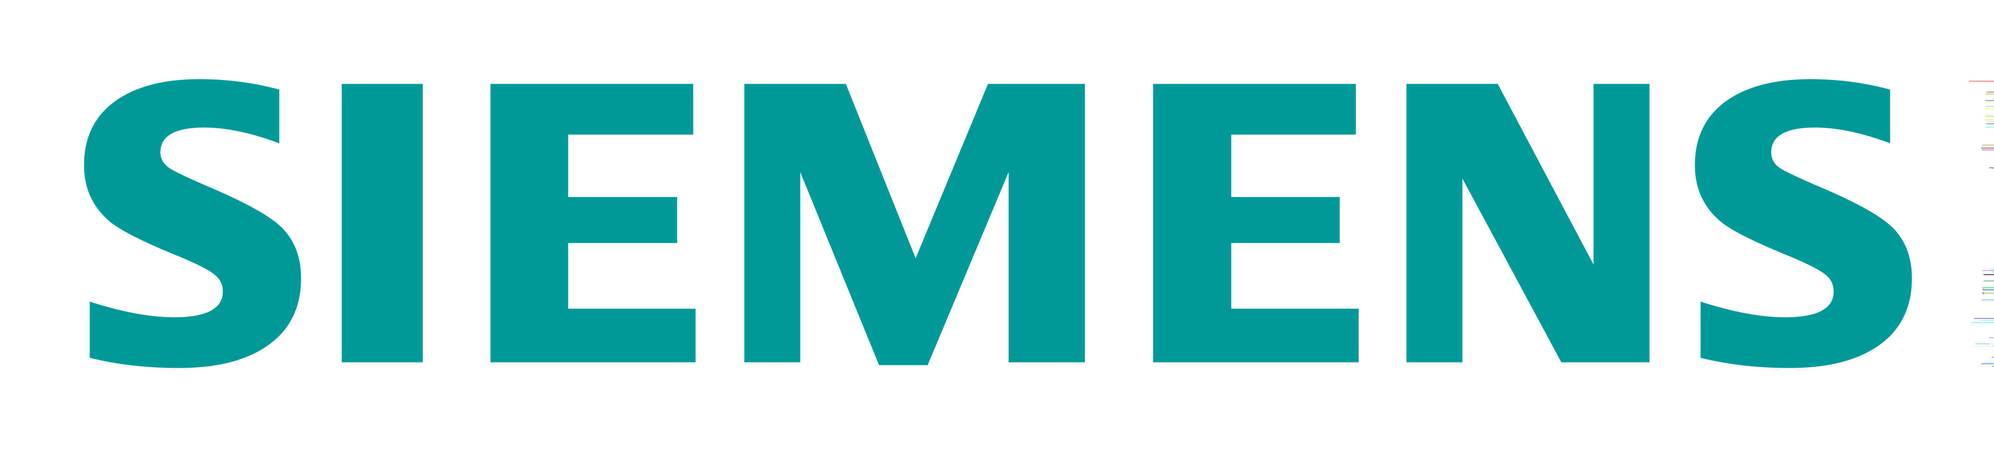

Siemens Health leverages technology to connect medical devices to the cloud through AKS
Challenge: | Siemens needed to speed up their development process to make the transition from value-added services provider to platform provider.
Solution: | Siemens adopted Azure Kubernetes Service (AKS) to speed up application development and run their microservices-based apps.
Outcome: | With AKS, Siemens has driven newfound product development agility. AKS enables them to use an applicant gateway and API management to manage exposure, control, and to meter the access continuously.
The managed Azure Kubernetes Service puts us really into a position to not only deploy our business logic in Docker containers, including the orchestration, but it’s also really easy through application gateway and API management to manage that exposure and control and meter the access continuously.
Thomas Gossler, Lead Architect - Digital Ecosystem Platform, Siemens
Click here to learn more

Slide 29
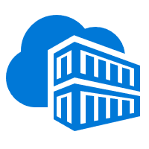
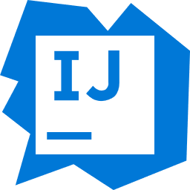

Azure Kubernetes Service (AKS)
App Service
Easily deploy and run container-based web apps at scale
App Service
Accelerated outer loop
Fully managed platform
Flexibility & choices
Azure Container Instances (ACI)
Tight integration w/ Docker Hub, Azure Container Registry
Automatic scaling and load balancing
From CLI, portal, or ARM template
Service Fabric
Built-in CI/CD w/ Deployment Slots
High availability w/ auto-patching
Single Docker image, multi container w/ Docker Compose
Azure Batch
Intelligent diagnostics & troubleshooting, remote debugging
Backup & recovery
IntelliJ, , Jenkin, Maven Visual Studio family
Azure Container Registry (ACR)

Slide 30
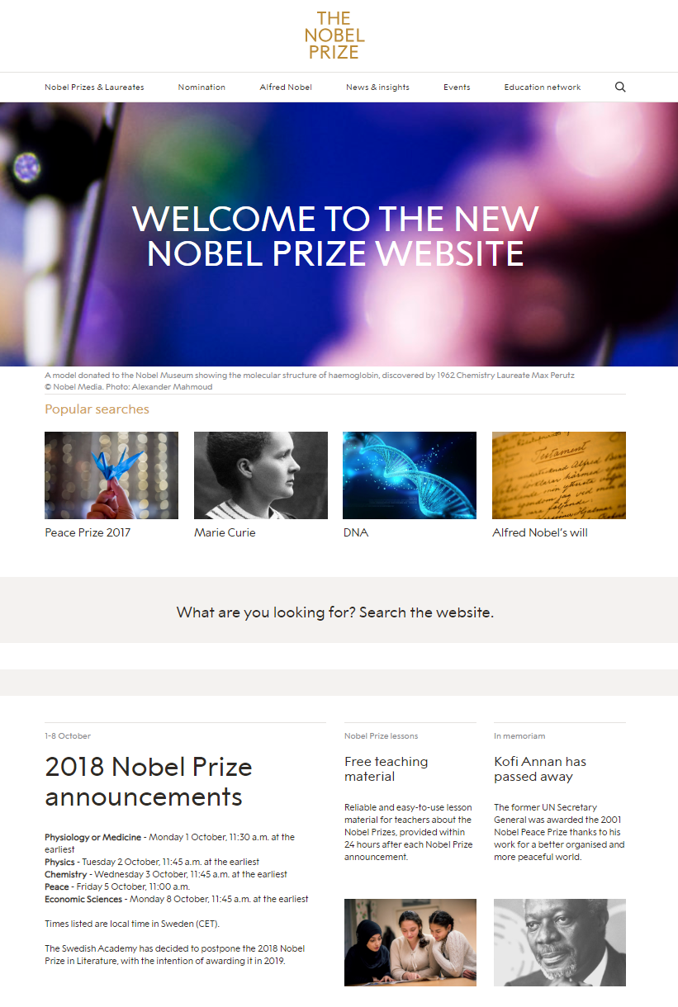
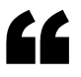
Relaunching the home of Nobel Prize awarded laureates and their discoveries
Challenge: | For the NobelPrize.org relaunch, Nobel needed simplicity at scale to modernize their 10,000+ page worldwide site ahead of the quickly-approaching Nobel Prize announcements, bringing millions of visits each year.
Solution: | To leverage the scalability and ease of PaaS, Nobel brought their containerized Linux application to Azure App Service Environment to ensure that their popular site can handle high traffic loads and meets their security requirements.
Outcome: | Because the Linux on ASE PaaS offering abstracts away the complications of maintaining infrastructure, it was simple for Nobel to quickly shift their traditional application to a modern, flexible app in time for announcement week. Simple to get started, but can seamlessly handle scale with little maintenance.
The use of [Azure App Service] allows us to rapidly test and implement new ideas with the mission to inform, inspire and engage our global audience on the Nobel Prize.”
Hans Mehlin, Chief Technology Office, Nobel Media
Click icon to visit the Nobel Prize website

Slide 31
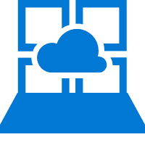

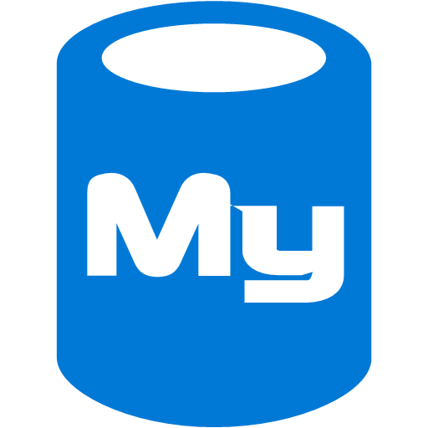
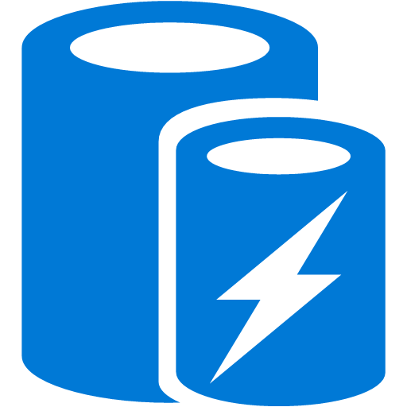

Nobel Prize website Deploy a global website using Linux containers in a PaaS environment
Public-facing endpoint
Run containerized applications without worrying about the infrastructure
Leave the scaling orchestration to our PaaS platform for hassle-free scaling for higher traffic loads
Secure your applications in an Azure Virtual Network to meet security requirements
Microsoft Azure
Linux on ASE
Azure Blob Storage
Developer
Visitor/editor/ developer
CDN
Azure MySQL
Azure Redis Cache
Containerized apps
Full page cache and SSL termination
Prod, staging slots, dev tools
Point 2 site VPN
Main virtual network
Candidator DC
Container Registry
Subnets
Network
ASE
Azure Redis Cache
Gateway
Digital asset management
VPN
Site 2 site VPN
Simple to get started, but also robust to handle global scale with little maintenance
Elastic Search traffic
Container Registry traffic
Internet

Slide 32
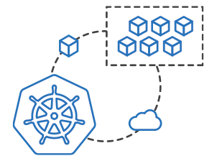
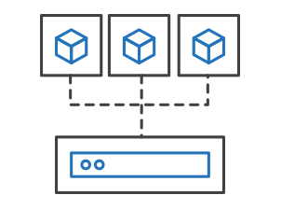
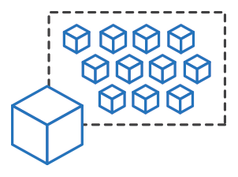
Azure Kubernetes Service (AKS)
Azure Container Instances (ACI)
Easily run containers on Azure without managing servers
App Service
Azure Container Instances (ACI)
Service Fabric
Run containers without managing servers
Increase agility with containers on demand
Secure applications with hypervisor isolation
Azure Batch
Azure Container Registry (ACR)

Slide 33
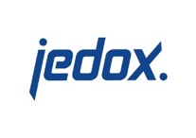


Rapidly growing software company attracts customers with seamless cloud demo experience
Challenge: | Jedox needed a more lightweight compute unit than virtual machines to power its website demos and provide a good customer experience.
Solution: | The company used Microsoft Azure Container Instances to support the Jedox Marketplace and power its demos.
Outcome: | With ACI, Jedox is able to spin up customer demos on demand, improve provisioning speed, build confidence in the cloud, and lower IT costs.
We are far more responsive to customer needs since adding Azure Container Instances. Our Marketplace demos are powerful marketing tools for Jedox, and we’ve used Azure to improve the customer experience significantly.
Vladislav Malicevic , Vice President Development and Support, Jedox
Click here to learn more

Slide 34


Azure Kubernetes Service (AKS)
Azure Service Fabric
A microservices platform for business critical applications
App Service
Build
Deploy
Operate
Azure Container Instances (ACI)
always-on, highly scalable microservice apps
</>
.NET
Service Fabric
</>
Azure Batch
Flexible infrastructure
Lifecycle management
24/7 availability & performance
Elastic scalability
Microservice and container orchestration
Security & compliance
Health & monitoring
Azure Container Registry (ACR)

Slide 35
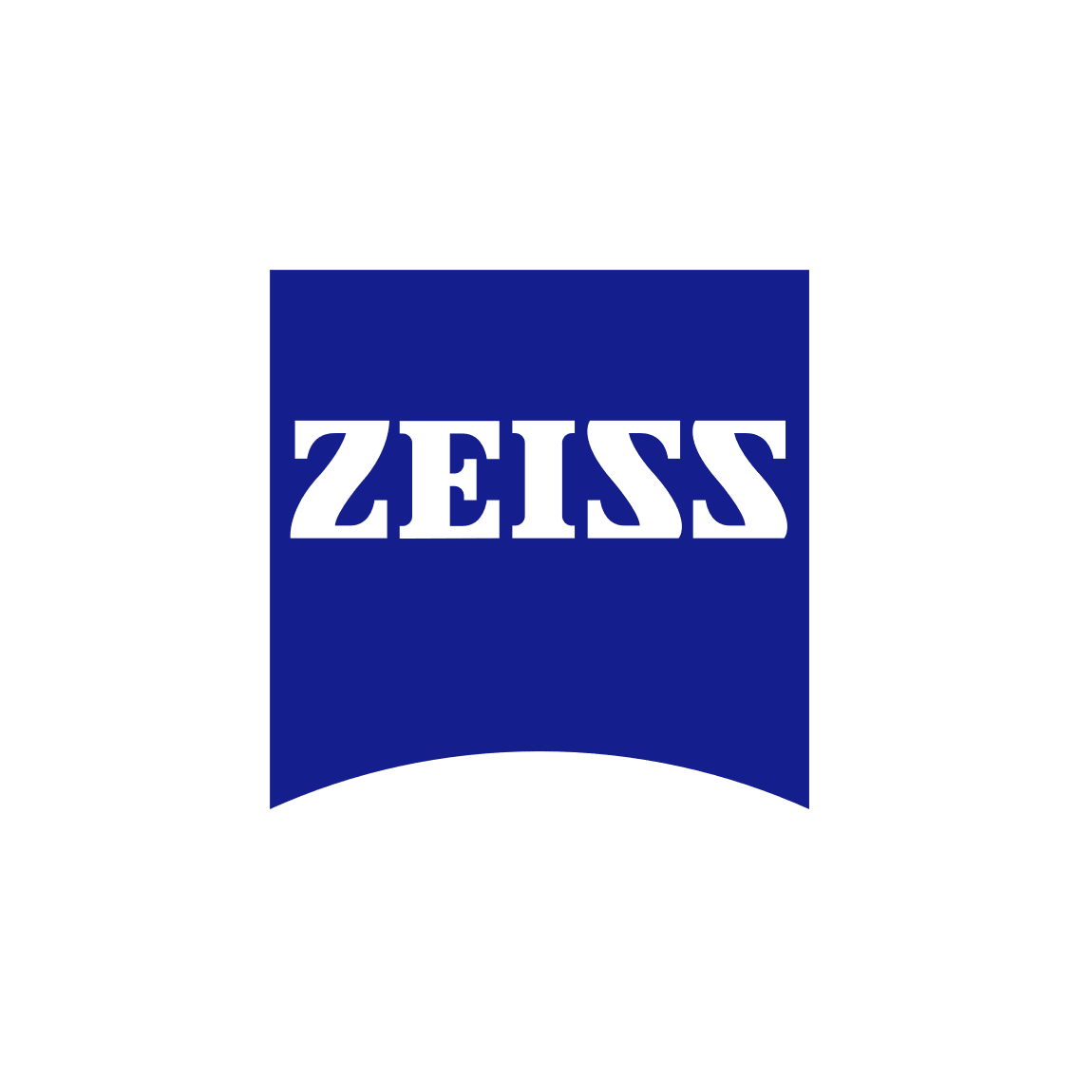
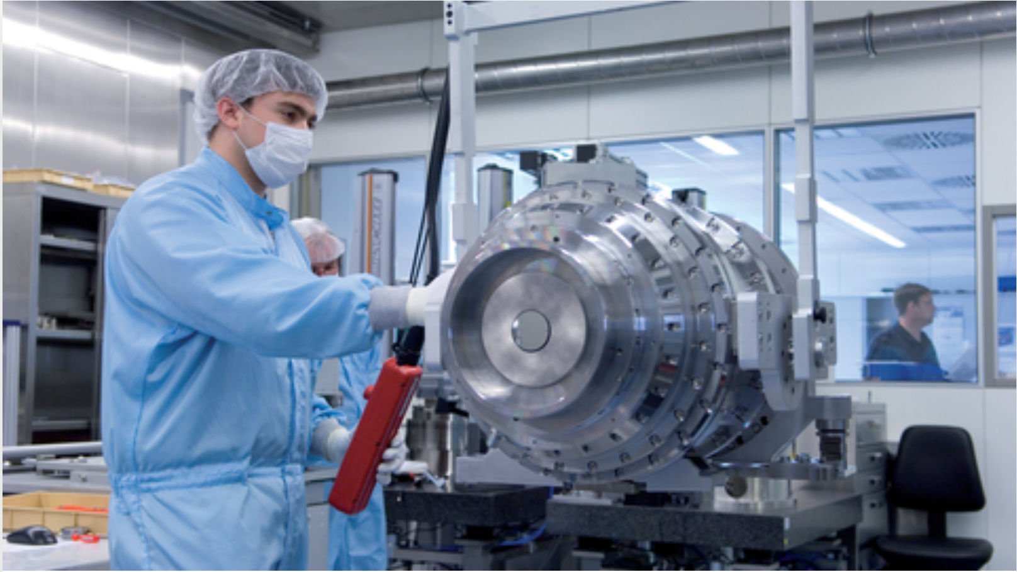
Zeiss creates smart devices by connecting field devices with back-end systems
Benefits: | Run Windows containers with existing code & new microservices together Securely expose business applications using REST APIs Improved agility makes it easier for developers to update container applications and services Scalable microservices-based platform for stateless/stateful workloads
With Service Fabric we rely on a robust and scalable platform which host our digital integration scenarios – stateful integrations in Reliable Services and stateless integrations in containers can be hosted side by side on one platform.
Kai Walter, Lead IT Solution Architect ZEISS Group

Slide 36
Azure Kubernetes Service (AKS)
Azure Batch
Run repetitive compute jobs using containers
App Service
Azure Container Instances (ACI)
Enable applications and algorithms to easily and efficiently run in parallel at scale.
Run Batch tasks without having to manage an environment and dependencies.
Package, execute, and scale your High Performance Computing applications and batch workloads in a consistent, reproducible manner.
Service Fabric
Azure Batch
Azure Container Registry (ACR)

Slide 37
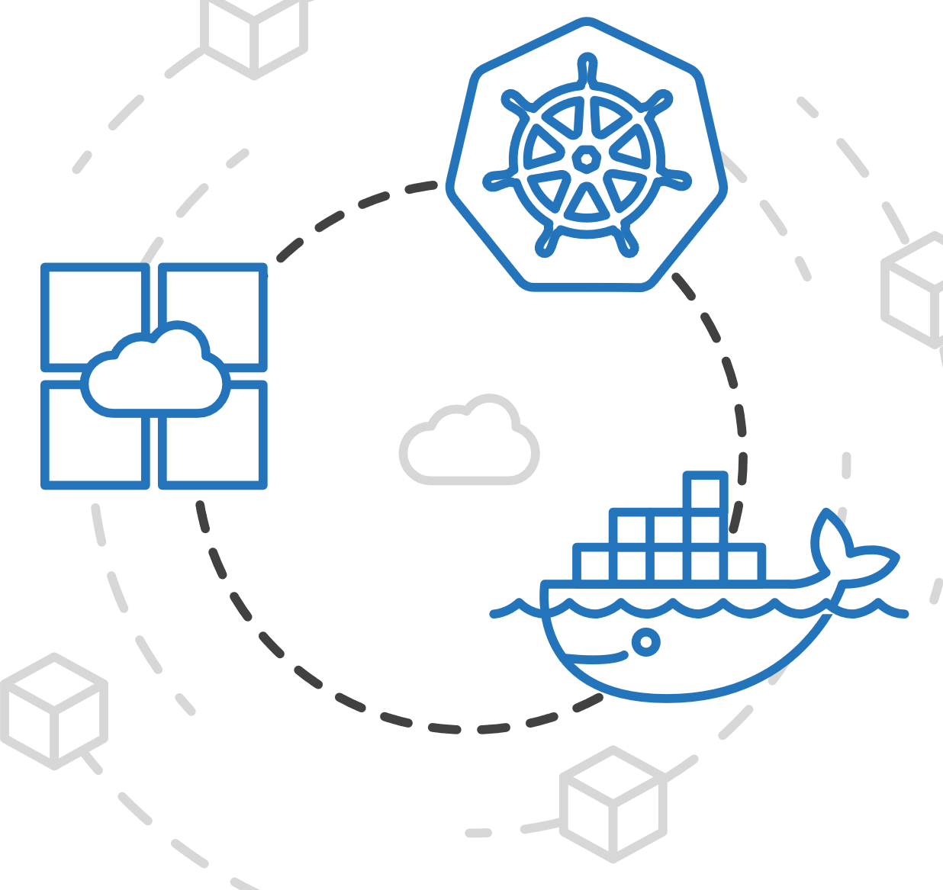
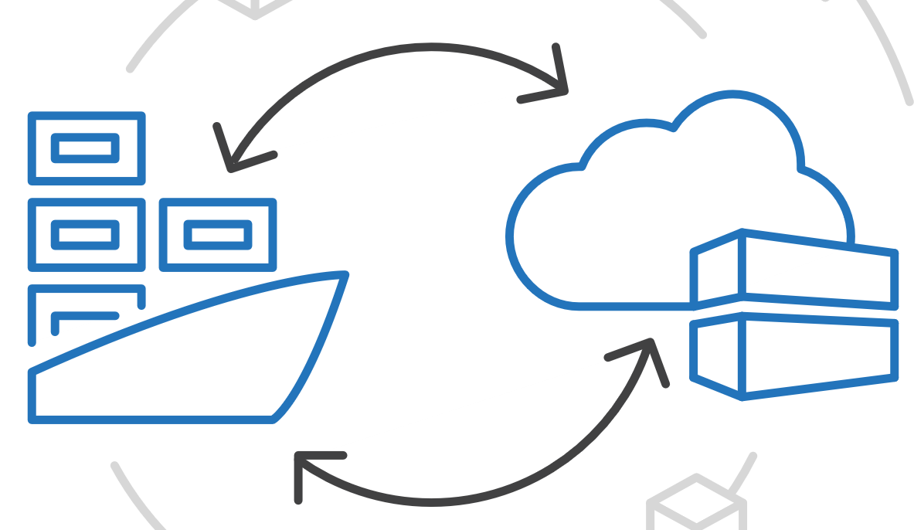
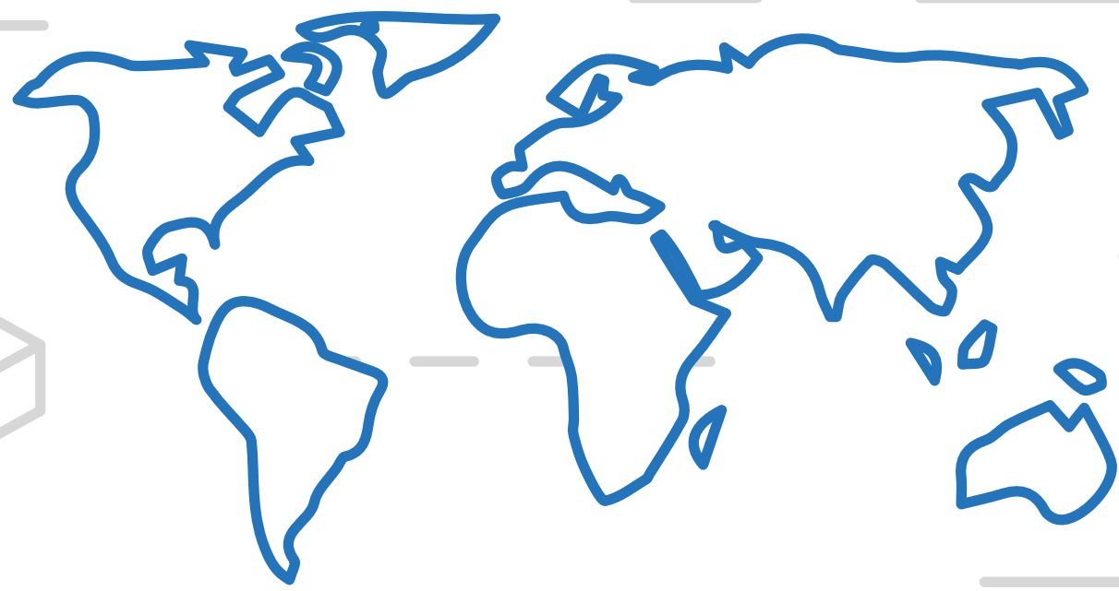
Azure Kubernetes Service (AKS)
Azure Container Registry (ACR)
Manage a Docker private registry as a first-class Azure resource
App Service
Azure Container Instances (ACI)
Service Fabric
Manage images for all types of containers
Use familiar, open-source Docker CLI tools
Azure Container Registry geo-replication
Azure Batch
Azure Container Registry (ACR)

